Slide 1

Exam AZ-500: Microsoft Azure Security Technologies Crash Course
Tim Warner

Slide 2
Session 2 Learning Goals
Sweep up yesterday's shavings
ASG membership
Emergency elevation
Custom RBAC roles
Compute security, continued
VMs, containers, App Service
Data platform security
AZ-500 cert strategy

Slide 3
Course Materials
timw.info/az500

Slide 4


Tim Warner
Based in Nashville, TN, US
MCT, MVP
Twitter: @TechTrainerTim
Badge: timw.info

Slide 5
Session 1 of 2 Learning Goals
Introduction
Manage identity and access
Administer Azure AD security
Configure Azure AD PIM
Implement platform protection
Configure network, container, host security
Manage security operations
Configure Azure Security Center

Slide 6
Session 2 of 2 Learning Goals
Manage security operations, continued
Configure Azure DevOps
Configure security policies
Configure security alerts
Secure data and applications
Configure data classification
Protect data infrastructure
Configure application security and Key Vault

Slide 7
Setting Expectations
The job role in play is the Azure Security Administrator
Identify which security controls are available for different Azure products and know their configuration basics
This is a "crash course"
Plan to review these materials more than once
Five-minute break at midpoint
Please ask/answer questions and provide feedback in the Q/A panel, not the group chat

Slide 8
2020 Certification Updates
Microsoft Worldwide Learning reviews each role-based certification yearly
Exam AZ-500 was last updated on September 24, 2020
Review the "Skills Measured" document: https://timw.info/500sm
Themes:
Eliminate redundancy
Azure Sentinel
Removed references to legacy technologies (HDInsight)

Slide 9
Tim's Certification Study Pyramid
Interdependence
Content knowledge
Practical application
Test-taking skills

Slide 10
Manage Identity and Access

Slide 11


Azure AD and Subscriptions

Slide 12
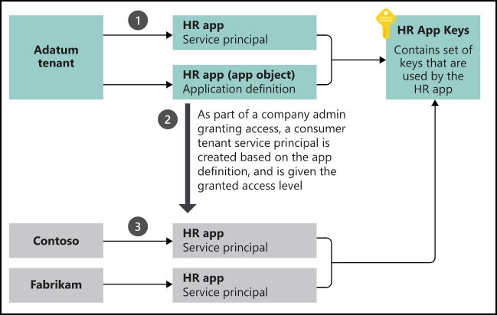
App registrations and service principals

Slide 13

Azure AD B2C

Slide 14

Azure AD Domain Services

Slide 15

Azure AD SSO

Slide 16

Passthrough Authentication

Slide 17

Seamless Single Sign-On

Slide 18

AD FS Federation

Slide 19
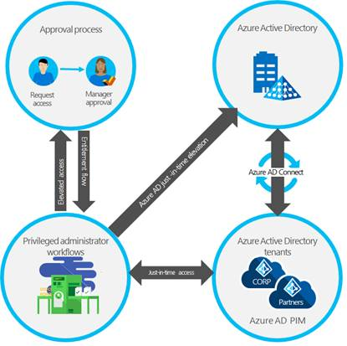
Azure AD PIM

Slide 20
Implement Platform Protection

Slide 21
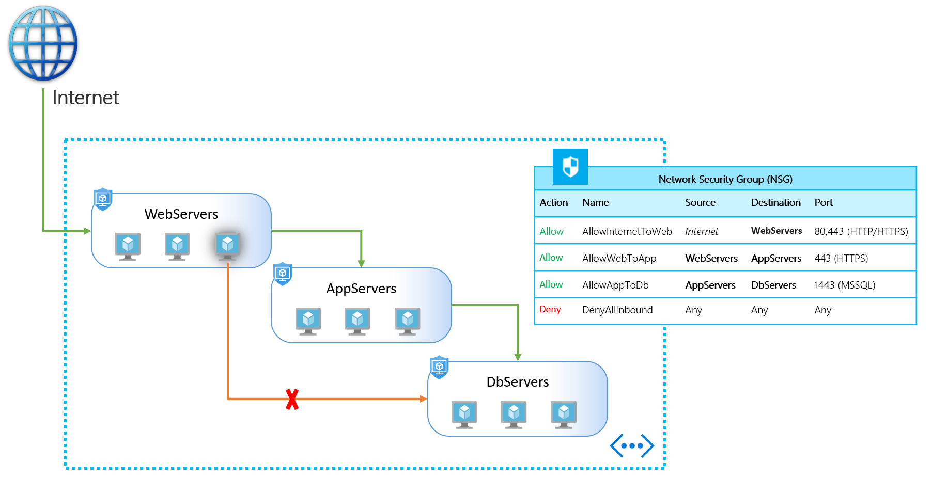
NSGs and ASGs

Slide 22

VM High Availability

Slide 23

Web App High Availability

Slide 24
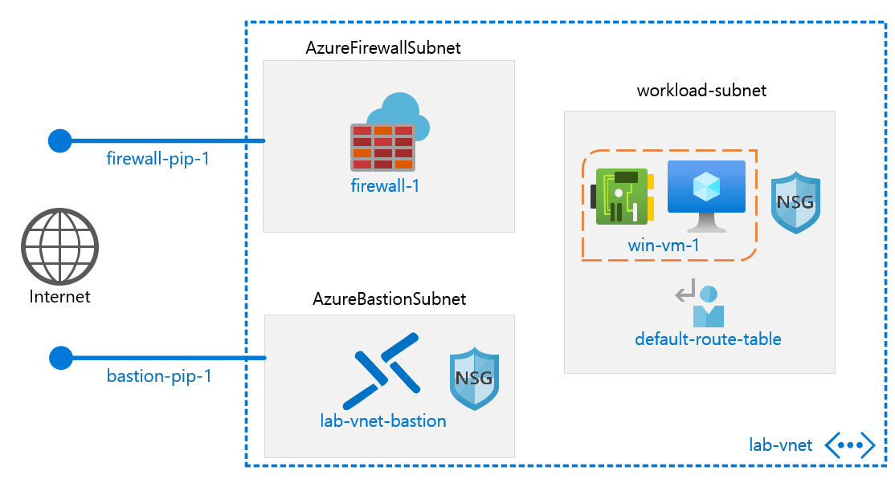
Azure Firewall

Slide 25
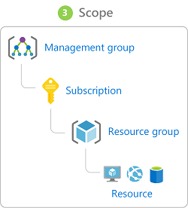
Azure Management Scopes
/ Tenant Root

Slide 26

Service endpoints

Slide 27
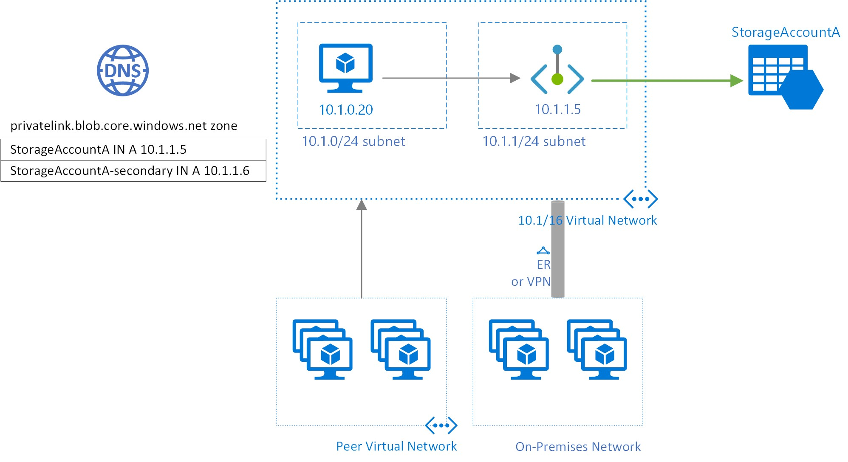
Private endpoints

Slide 28
Manage Security Operations

Slide 29
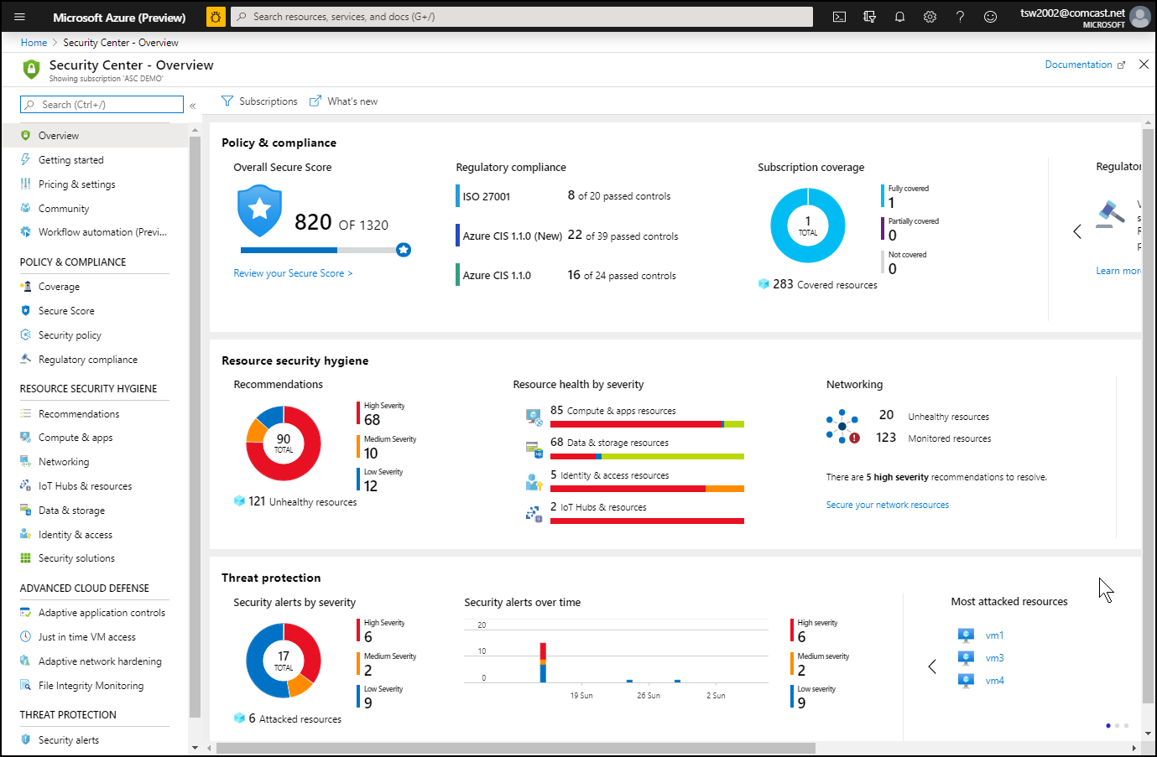
Azure Security Center

Slide 30
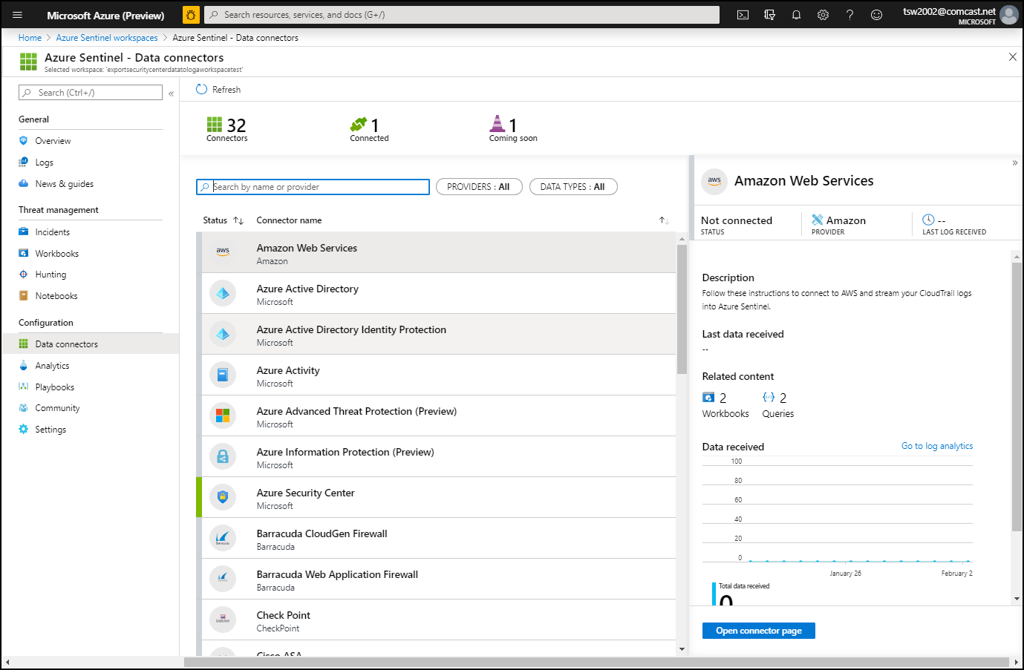
Azure Sentinel

Slide 31
Secure Data and Applications

Slide 32
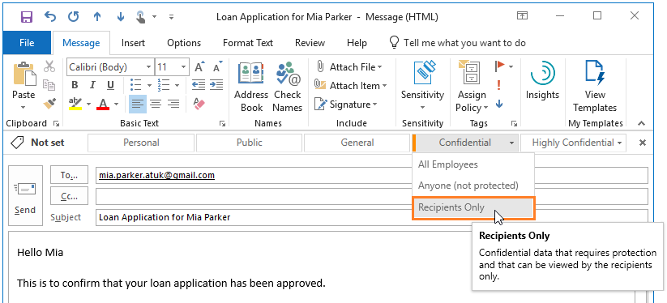
Azure Information Protection

Slide 33
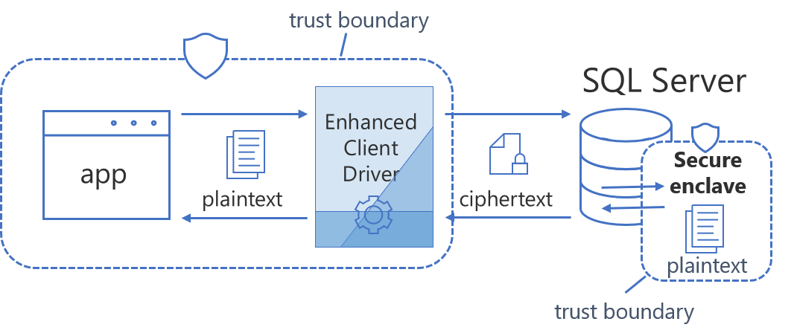
Always Encrypted

Slide 34
Exam AZ-500 Item Types

Slide 35

Single Answer Multiple Choice

Slide 36

Multiple Answer Multiple Choice

Slide 37
Repeated Scenario
You need to move an Azure VM to another hardware host.
Solution: You redeploy the VM.
Does this solution meet the goal?
Yes
No

Slide 38
Repeated Scenario
You need to move an Azure VM to another hardware host.
Solution: You enable boot diagnostics.
Does this solution meet the goal?
Yes
No

Slide 39

Select and Place

Slide 40

Build List and Reorder

Slide 41

Active Screen/Fill in the Blank

Slide 42

Case Study

Slide 43






Performance-Based Lab

Slide 44
Microsoft Online Testing

Slide 45

Microsoft Online Testing Process

Slide 46

Microsoft Online Testing Process

Slide 47

Microsoft Online Testing Process

Slide 48

Microsoft Online Testing Process

Slide 49

Microsoft Online Testing Process

Slide 50

Microsoft Online Testing Process

Slide 51

Microsoft Online Testing Process

Slide 52
AZ-500 Exam Strategy
Focus your skills accordingly:
60 percent Azure portal
20 percent Azure PowerShell
10 percent Azure CLI
10 percent KQL
Azure AD PIM all day long
Expect performance-based labs, but be happy if you don't see 'em

Slide 53
Parting Advice
Check out my YouTube (timw.info)
Online testing
Cert item strategy
AZ-500 study guide
Invest in Whizlabs or MeasureUp
Register for your exam ASAP!

Slide 54
Thank you!
Course materials: timw.info/az500
Twitter: @TechTrainerTim
Work: timw.info/ps
Web: timw.info

